Slide 1
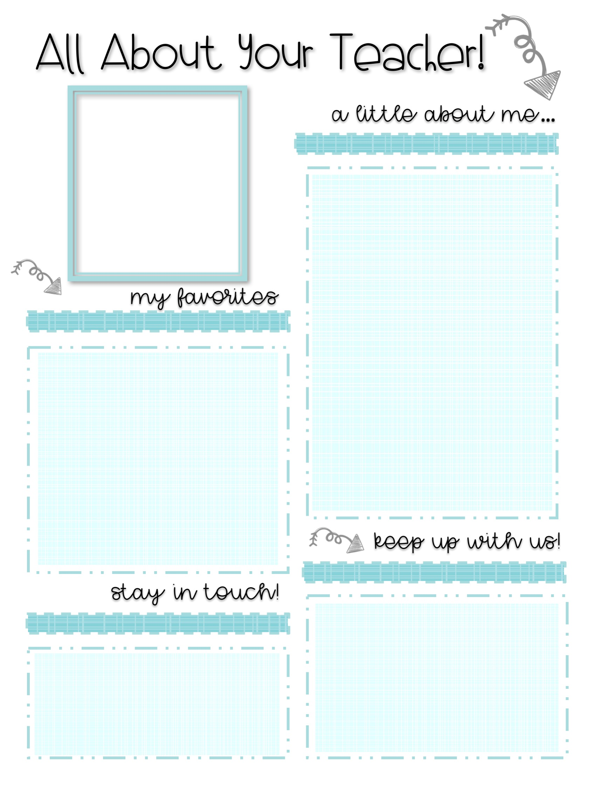
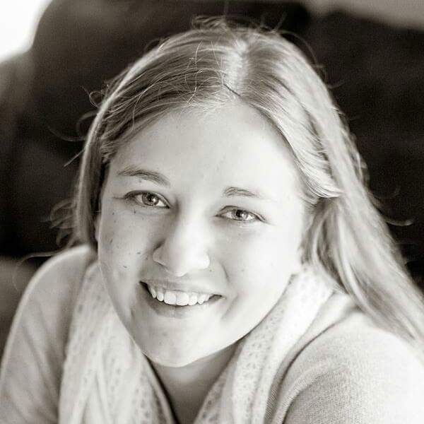
My name is Kelli Strother and I am so glad that you and your student are apart of my class this year! This is my 2nd year here at Swift Creek and I am looking forward to working with you. Before working here at the Creek and during the most recent summer, I worked alongside some world class scientists through the Nation High Magnetic Field Laboratory RET program conducting research into drug resistant TB and finding possible new drug target sites.
I played softball for 6.5 years and have been working with our school team this past year. I played alto saxophone in my high school marching band.
Science has always been one of my passions and I cannot wait to share it with you!
Fast food: Whataburger
Coffee: Starbucks
Color: Lime green
Animal: Horses
On the weekends you might find me in Lake Talquin State Forest hiking with my dog or riding horses out east of town. I also enjoy curling up with a good book and a cup of coffee or Earl Grey tea.
Want to see what we are up to in class?
Follow my teacher accounts below!
IG: @missstrother
Twitter: @Ms_Strother
Email (preferred): strotherk@leonschools.net
Phone: 850-414-2670
Remind101: text the code below to 81010
Comprehensive Science: @6thcompsc
Bridge: @6thbrid
Physical Science: @physsci192

